Slide 1

A Laughing Matter -
Black Sitcoms in Review,
1950 to 2000
A Laughing Matter is about negotiating the authenticity of Black life in American culture, using stereotypes that peel back the layers of embedded systemic challenges, with hopes of increasing your awareness about marginalized people of color through situation comedies. Examine what each sitcom, over a 50-year period, reveals about us.
Meanwhile, don’t choke on the joke!

Slide 2
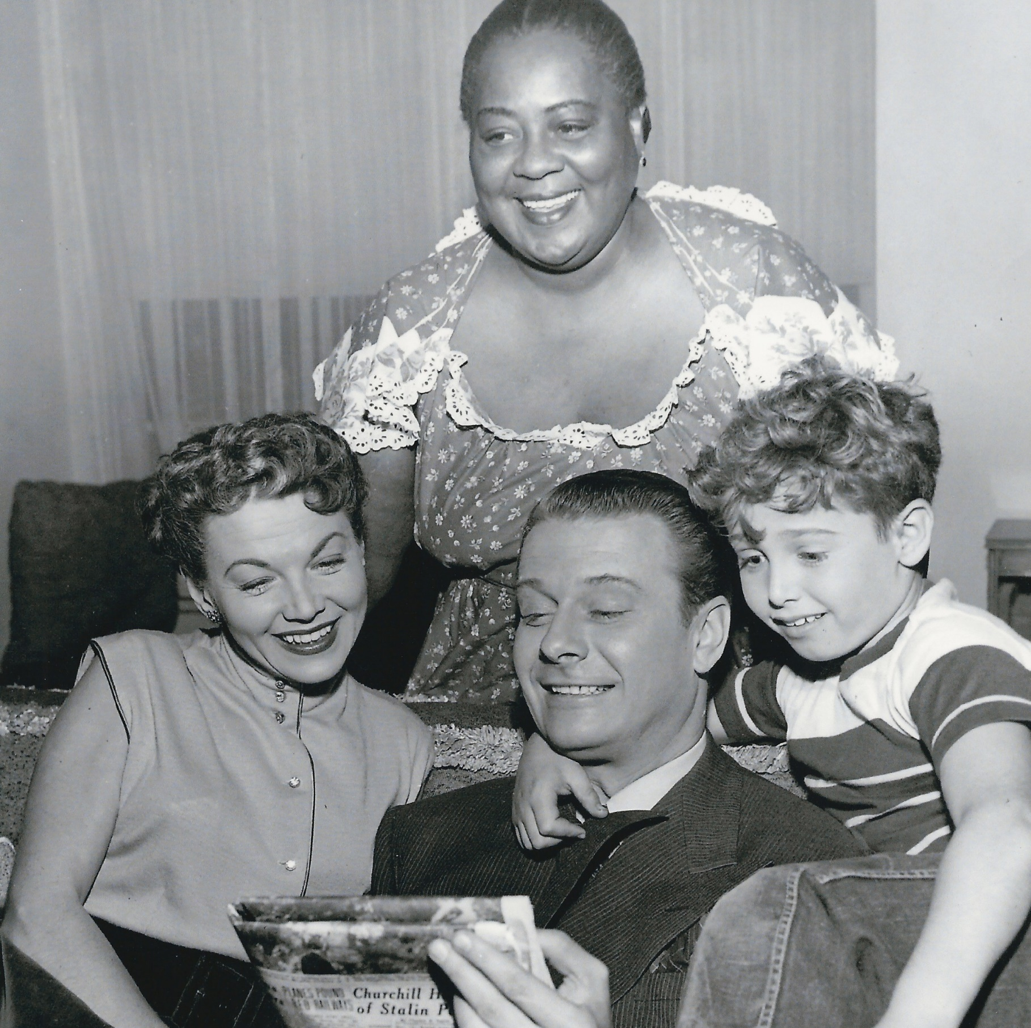

1950s
Beulah – 1950, Starring legendary silver screen Queens like Hattie McDaniel, Louise Beavers and Ethel Waters was America’s favorite Black maid that came to the rescue of hapless white families. The sitcom also featured Butterfly McQueen and Ruby Dandridge as Oriole. Ethel Waters became the first Black woman to star on a TV network show. The Beulah character was often viewed as a stereotypical “mammy” figure.

Slide 3
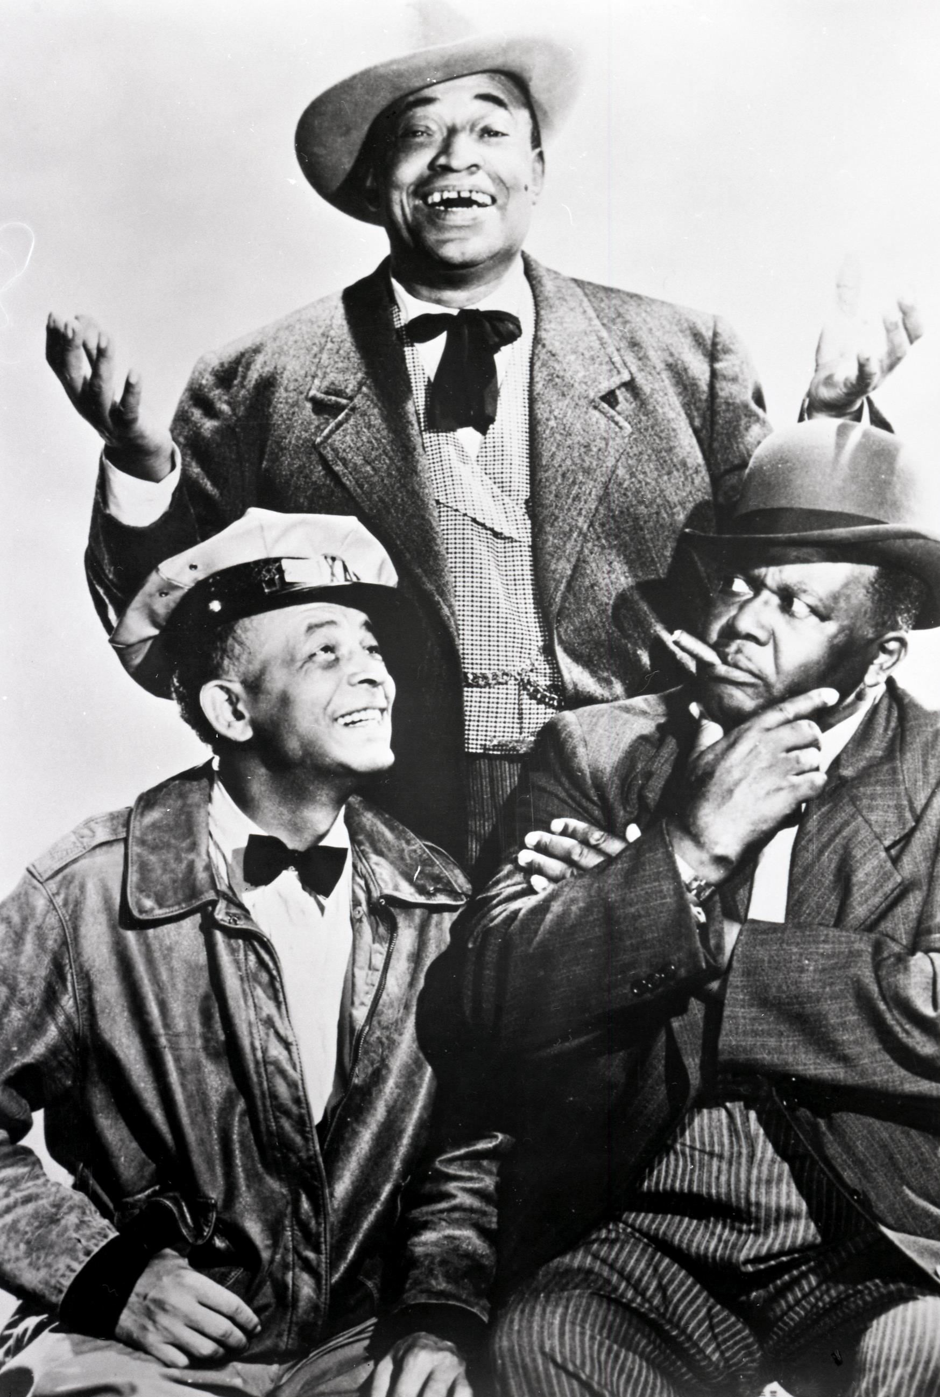
1950s
Amos ‘N’ Andy – 1951, Set in Harlem, Amos ‘n’ Andy centered around the George Stevens (Tim Moore), a conniving conman always looking to make a Benjamin. Known as “Kingfish” he got most of his brothers from the Mystic Knights of the Sea Lodge involved in his schemes. Amos (Alvin Childress) was the philosophical cabdriver, while the gullible Andy (Spencer Williams) was often the target of Kingfish’s pranks. Ernestine Wade played Sapphire, Nick Stewart starred as Lightnin’ with Amanda Randolph as Mama. The show had a syndicated run from 1954 through 1966.

Slide 4
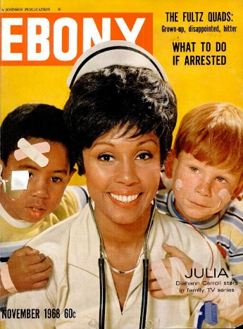
1960s
JULIA – 1968, Diahann Carroll plays Julia, a widowed nurse whose husband was killed in Vietnam, and mother of a young son, Corey played by Marc Copage. She worked for Dr. Chegley (Lloyd Nolan) whose bark was much worse than his bite. Julia lived in a modern integrated apartment building and her son’s best friend was a white lad. Julia’s love interest was Paul Cameron, played by Paul Winfield. Life at the medical office, raising a son and social interactions provided plenty of material for some “wokeness” during the dawning of the Civil Rights era.

Slide 5
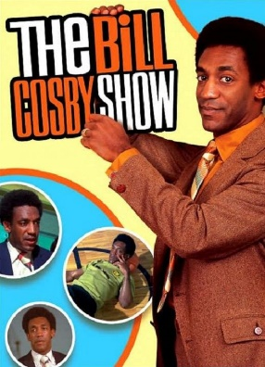
1960s
BILL COSBY SHOW – 1969, Cosby plays Chet Kincaid a physical education teacher and coach at a lower-middle-class Los Angeles high school. Kincaid’s relationship with students, their parents and colleagues allowed for Cosby’s gentle sense of humor and philosophy. The series marked the first time an African American man starred in their own comedy series.

Slide 6
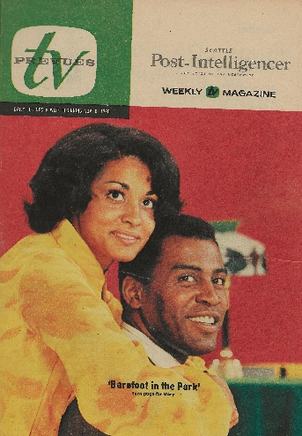
1970s
BAREFOOT IN THE PARK – 1970, This was the Black version of Neil Simon’s play and movie about young newlyweds trying to manage a life on a shoestring budget while living in a run-down lower Manhattan walk-up apartment. Scoey Mitchell plays a lawyer Paul Bratter, while Tracy Reed plays his wife “Corie.” Mabel Bate’s (Thelma Carpenter) persistent suitor was Honey (Nipsey Russell).

Slide 7
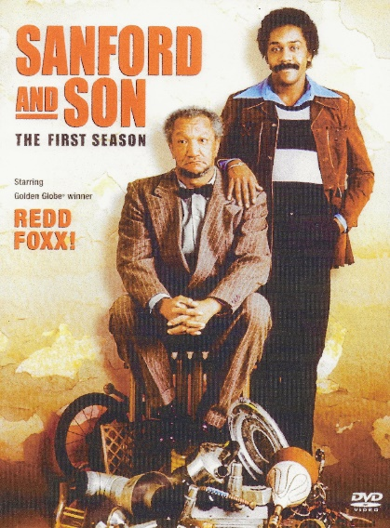
1970s
SANFORD AND SON – 1972, Fred Sanford (Redd Foxx) was a 65-year-old junk dealer with a 34-year-old son, Lamont (Demond Wilson). Fred was happy with the meager income from the junkyard, while Lamont wanted a more lucrative business. Fred was constantly at odds with the deeply religious, bible-toting Aunt Esther (LaWanda Page), who ran the Sanford Arms, a run-down rooming house located next door to the junkyard. The sitcom was known for its racial humor, bigotry, running gags and catchphrases like “I gonna git you sucker” and “This is the big one, Elizabeth! I’m coming to join ya, honey.”

Slide 8
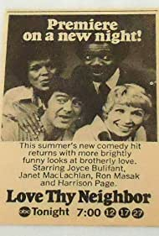
1970s
LOVE THY NEIGHBOR – 1973, A young Black couple move into a previously all-white neighborhood in suburban Sherwood Forest Estates. Charlie (Ron Masak) and Peggy Wilson (Joyce Bulifant) discovered that their Black neighbor (Harrison Page) is the new efficiency expert at Turner Electronics, the company where Charlie is the union shop steward.

Slide 9
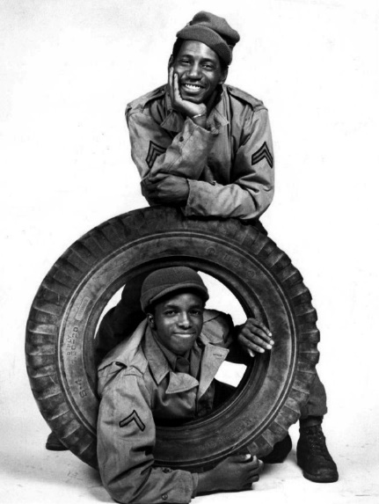
1970s
ROLL OUT – 1973, Set in France during World War II, the sitcom was the story about men of the 5050th Trucking Company, better known as the “Red Ball Express,” a trucking unit that provided supplies to troops on the front lines. Corporal Sweet (Stu Gilliam) and Private Jed (Hilly Hicks) were sometimes rowdy but always dependable in delivering their loads efficiency and on time. Based on a true story of a transportation unit.

Slide 10
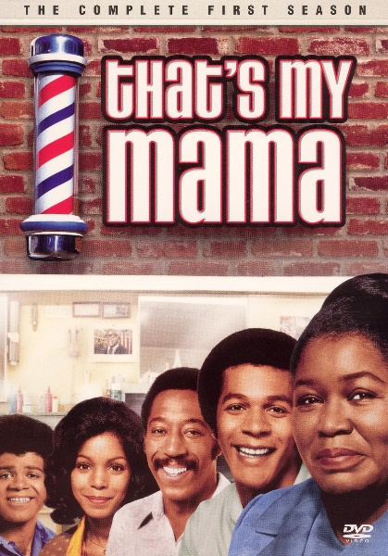
1970s
THAT’S MY MAMA – 1974, Clifton Curtis (Clifton Davis) was a barber in a Black middle-class neighborhood of Washington, DC. Although happy with the single life, his Mama Eloise (Theresa Merritt) wanted to find him a mate, like his sister Tracy Curtis (Lynne Moody). The ethnic barbershop had its array of characters; a street peddler, a philosopher, jokester, and checkers and dominoes players.

Slide 11
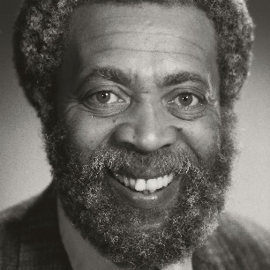
1970s
GRADY – 1975, a spin-off from Sanford and Son, Grady Wilson (Whitman Mayo), one of Fred Sanford’s friends moves out Watts and into the racially mixed neighborhood of Westwood, a suburb of Los Angeles, with his married daughter Ellie (Carole Cole) and their two kids. The show only had 12 episodes.

Slide 12
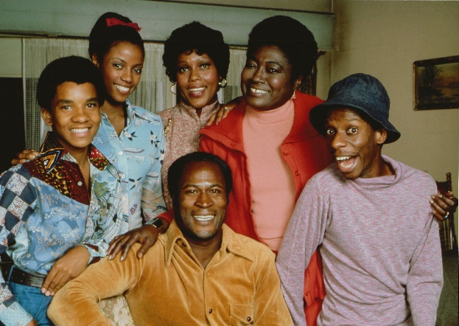
1970s
GOOD TIMES – 1974, Florida (Esther Rolle) and James Evans, with two sons and a daughter, lived in a high-rise ghetto on Chicago’s South Side. While James (John Amos) often worked two jobs and portrayed a strong father figure, his son J.J. (Jimmy Walker) was characterized as a buffoon sporting a chicken hat and saying “DY-NO-MITE” on every show. Florida was a devout Christian, while daughter Thelma (Bern Nadette Stanis) was sophisticated and graceful, in essence, became TV’s first Black female sex symbol of sitcoms.

Slide 13
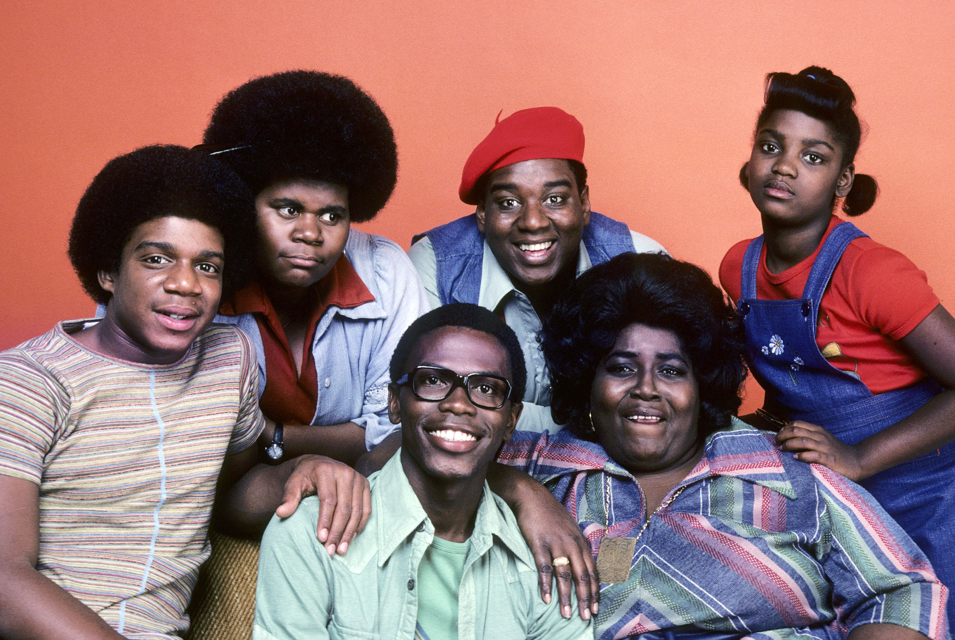
1970s
WHAT’S HAPPENING !! – 1976 & 1985, An urban comedy about three spirited kids in the big city. Raj (Ernest Thomas) is the studious dreamer and wannabe writer; Rerun (Fred Berry) is the jolly overweight clown who speaks without thinking and Dwayne (Haywood Nelson) is the shy tag-along with a cool vibe. They hang out at Rob’s a diner where Shirley (Shirley Hemphill) is the wise-cracking waitress. In its return to TV in 1985, now called What’s Happening Now, Raj is now married, Rerun is a used car salesman and Dwayne is a computer programmer. The series is loosely based on the movie Cooley High.

Slide 14
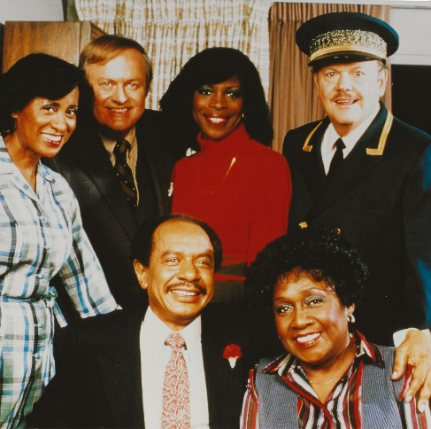
1970s
THE JEFFERSONS – 1975, George Jefferson (Sherman Hemsley) was the black-bigot version of Archie Bunker. Owner of a dry-cleaning business, George’s success allowed him and his wife Louise or Weezy (Isabel Sanford) to move into a luxury high-rise apartment on Manhattan’s East Side. The newly found wealth enabled George to be self-centered, bossy and snobbish. His son Lionel (Mike Evans) dated Jenny (Berlinda Tolbert), the product of an inter-racial marriage, much to George’s disdain. Added humor was provided by the Jeffersons’ wise-cracking, no-nonsense maid Florence (Marla Gibbs) with occasional snaps from the doorman Ralph (Ned Wertimer). The theme song “Moving On Up” was sung by Jeff Barry and Ja’net DuBois.

Slide 15
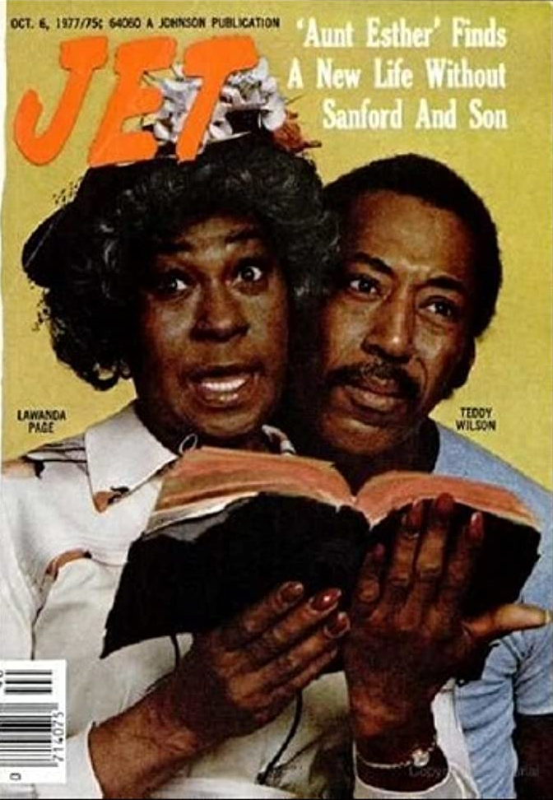
1970s
SANFORD ARMS – 1977, Phil Wheeler (Theodore Wilson), a widower with two teenagers buys Fred Sanford’s junk yard and attempts to turn the eyesore into a residential hotel. Fred’s sister-in-law Esther (LaWanda Page) becomes the property manager and advises Phil’s girlfriend Jeannie (Bebe Drake-Hooks) and children Angie (Tina Andrews) and Nat (John Earl) with modest success.

Slide 16
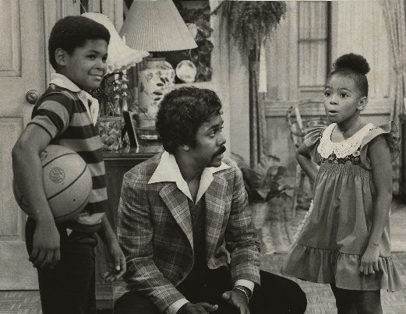
1970s
BABY, I’M BACK – 1978, Raymond Ellis (Demond Wilson) is a compulsive gambler who abandoned his wife Olivia (Denise Nicholas), son Jordan (Tony Holmes) and daughter Angie (Kim Fields) and heads to California. Seven years later, Raymond finds out that his wife plans to remarry to Colonel Wallace Dickey (Ed Hall), and that he has been declared legally dead. This prompts Raymond to move back to Washington, D.C., where he tries to win back Olivia by proving he is a better husband, and father to his kids, and to prove that he is still alive. Meanwhile, he must contend with his mother-in-law Luzelle (Helen Martin).

Slide 17
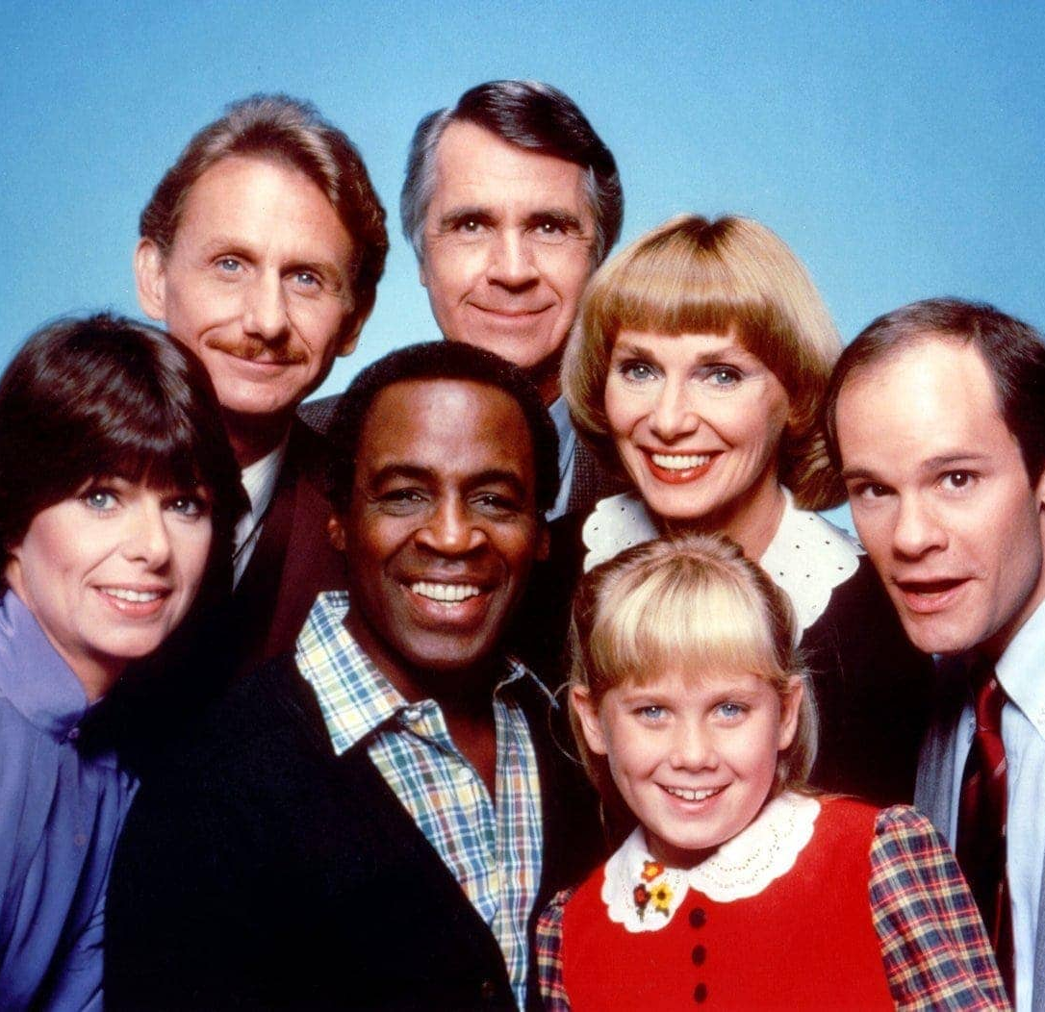
1970s
BENSON – 1979, The show focused on the conflicts and relationships within Governor James Gatling's (James Noble) household, with Benson (Robert Guillaume) generally providing a sarcastic voice of reason. Benson was in constant battle with the formidable German housekeeper Gretchen (Inga Swenson) and helping raise the Governor’s precocious daughter Katie (Missy Gold), while assisting the meek Governor in making politically and personally decisions.

Slide 18
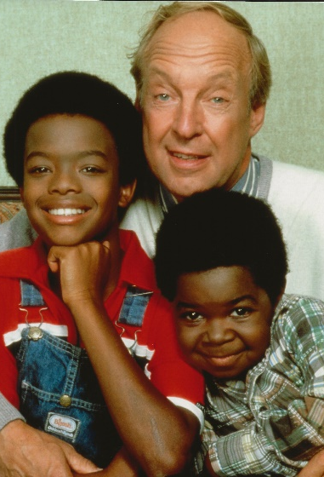
1970s
DIFF’RENT STROKES – 1978, Eight-year-old Arnold (Gary Coleman) with pudgy cheeks, twinkling eyes and tidbits of wisdom, along with his 12-year-old brother Willis (Todd Bridges) are two Black kids from Harlem are welcomed, after the sudden death of their mother, into Phil Drummond’s (Conrad Bain) luxury Park Avenue apartment. Mr. Drummond often introduced the kids as his “sons.” Also, presence was the widower’s 13-year-old daughter Kimberly and their scatterbrained housekeeper, Mrs. Garrett (Charlotte Rae). Known for the catchphrase, “What'chu talkin' 'bout, Willis?”.

Slide 19
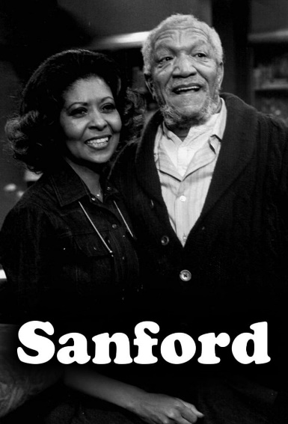
1980s
SANFORD – 1980, Fred (Redd Foxx) is back at his Watts junkyard, along with two new partners, as Lamont is away working on the Alaskan pipeline. One partner is Rollo (Nathaniel Taylor), a holdover from the original Sanford and Son, and Cal (Dennis Burkley), an obese white Southerner who invested $2,000 to become partner in “The Sanford Empire.” Cal moves into Lamont’s bedroom while Rollo works as a delivery man for the junk empire.

Slide 20

1980s
ONE IN A MILLION – 1980, Shirley Hemphill, who played the overpowering Black waitress on What’s Happening, got her own show. In One in a Million, Shirley [Simmons] is a down-to-earth, sharp-tongued cabdriver who inherits Grayson Enterprises, a multimillion-dollar, white-run conglomerate, when Jonathan Grayson, a regular customers died. As CEO, she challenges the corporate big wigs to do the right thing for its employees. Shirley finds an ally in Nancy (Dorothy Fielding), Grayson’s secretary. The series is set in New York City.

Slide 21
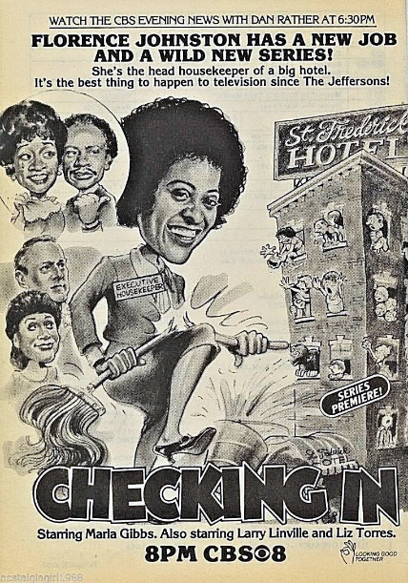
1980s
CHECKING IN – 1981, In this spin-off from The Jeffersons, Florence (Marla Gibbs) becomes an executive housekeeper at the St. Frederick, one of Manhattan’s elite hotels. The series follows Florence's misadventures at the hotel with her co-workers: Lyle (Larry Linville), her stuffy manager; Elena (Liz Torres), her assistant; Earl (Patrick Collins), the inept house detective; Hank (Robert Costanzo), the lewd handyman; Betty (Ruth Brown), the floor supervisor; and Dennis (Jordan Gibbs), the bellboy.

Slide 22
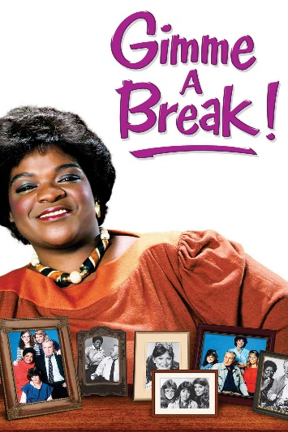
1980s
GIMME A BREAK – 1981, Nell Carter stars as Nellie Ruth, as stout Black housekeeper in the home of a widowed, overweight white police chief (Dolph Sweet) with his three daughters, ranging in age from cute grade-schooler to troublesome teen. Wisecracks and fat jokes were the norm, as Nell tries to be a friend and a surrogate mother to the family.

Slide 23
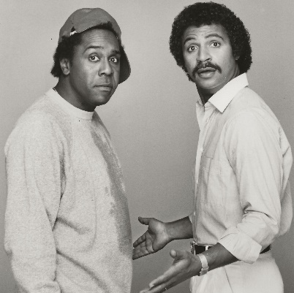
1980s
THE NEW ODD COUPLE – 1982, This time the principals are Black men with Ron Glass playing the prissy, neat freak photographer Félix, and Demond Wilson as the fun-loving and sloppy sportswriter Oscar. John Schuck also appeared as “Murray the Cop,” who was kept Caucasian. This was ABC’s second failed attempt to stage a Neil Simon comedy with Black actors – the first being Barefoot in the Park.

Slide 24
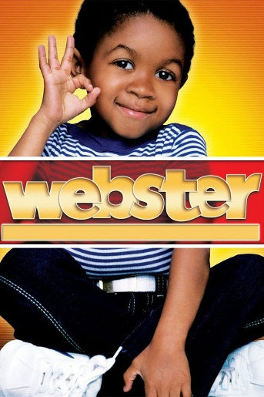
1980s
WEBSTER – 1983, The show stars Emmanuel Lewis in the title role as a young boy who, after losing his parents, is adopted by his NFL-pro godfather, portrayed by Alex Karras, and his new socialite real-wife, played by Susan Clark. The focus was largely on how this impulsively married couple had to adjust to their new lives and sudden parenthood, but it was the congenial Webster himself who drove much of the plot. Like NBC's earlier series Diff'rent Strokes, Webster featured a young African-American boy adopted by a wealthy white family.

Slide 25
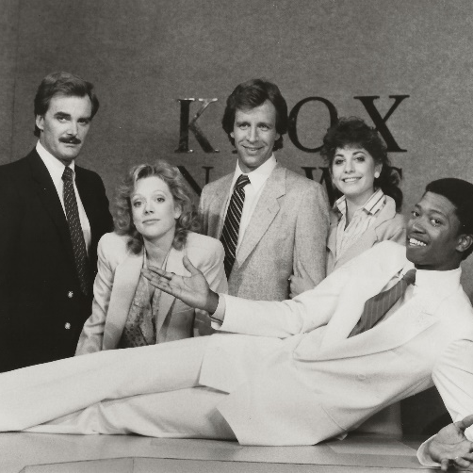
1980s
JUST OUR LUCK – 1983, A version of the 1960s sitcom I Dream of Jeannie and starred Richard Gilliland (Keith Burrows) as a mild-mannered TV weatherman for KPOX-TV, and T. K. Carter (as Shabu) as a hip, fun-loving 3,000-year-old genie who is freed by Gilliland after being imprisoned in his bottle for nearly two centuries. the subject of controversy when the NAACP charged the show with promoting negative stereotypes of African-Americans. The show was cancelled after 13 episodes. According to Carter, “Shabu doesn't have a master because he doesn't believe in masters. . . I made it clear that I won't do that jive routine, acting like some cat in a black El Dorado, drinking a Kool-Aid daiquiri with a hat as big as a house. . . When Shabu pops out of the bottle, he's wearing a Bill Blass raw silk suit. You're not going to see me wearing a lot of jewelry and stuff.”

Slide 26
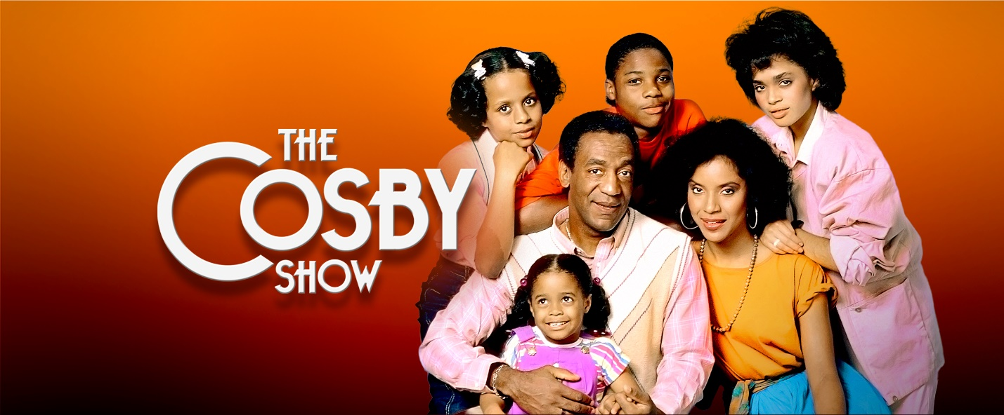
THE COSBY SHOW – 1984, The show focuses on the Huxtable family, an African-American upper-class family, living in a brownstone in Brooklyn Heights, New York. The patriarch is Cliff Huxtable (Bill Cosby), an obstetrician and son of a prominent jazz trombonist. The matriarch is his wife, a legal-aid attorney Clair Huxtable (Phylicia Rashad). They have four daughters and one son: Sondra, Denise, Rudy, Vanessa, and Theo. The Cosby Show was criticized for its unrealistic portrayal of Blacks as wealthy, well-educated professionals, and for its lack of attention to Black/White relationships. Others defended it as providing role models for what Blacks could achieve, and lessons for all races in how to raise a family in a calm and loving environment.

Slide 27
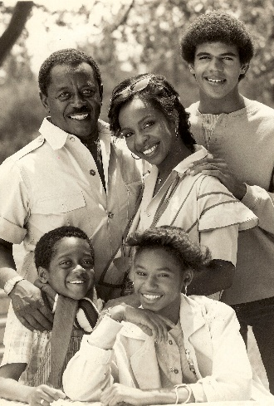
1980s
CHARLIE & CO. – 1985, About a middle class African American family who lived on the South Side of Chicago. Charlie Richmond (Flip Wilson) is an employee of the city’s Division of Highways, who juggled his work and home life with Diana, a schoolteacher played by Gladys Knight. The couple had three children: sixteen-year-old "Junior" (Kristoff St. John), fifteen-year-old Lauren (Fran Robinson), and nine-year-old Robert (Jaleel White). Viewed by some as a poor-man’s version of popular The Cosby Show.

Slide 28
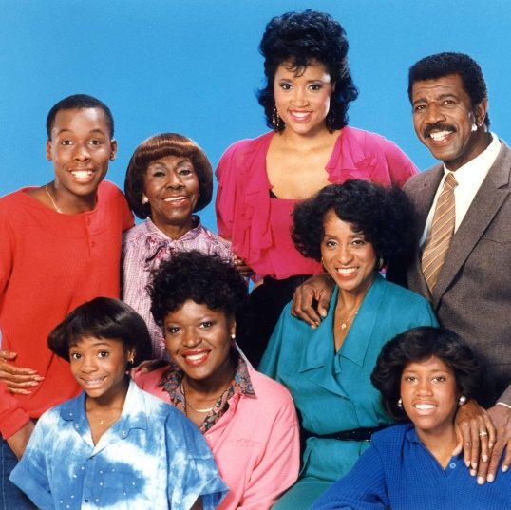
1980s
227 – 1985, The series stars Marla Gibbs as Mary Jenkins, a sharp-tongued, inner-city resident gossip and housewife. Other main characters include her husband Lester (Hal Williams), owner of a construction company, their smart and studious daughter Brenda (Regina King’s first role), the stoop-sitting landlady Rose Halloway (Alaina Reed Hall), the sexy dressing Sandra Clark (Jackée Harry) and the busy-body snooping Pearl Shay (Helen Martin).

Slide 29
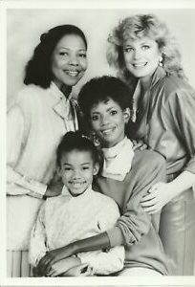
1980s
MELBA – 1986, Adapting to life after divorce, Melba Moore was raising her 9-year-old daughter, Tracy (Jamilla Perry), with the help of Mama Rose (Barbara Meek), who lived with them. Melba’s best friend was her white “sister,” Susan (Gracie Harrison), who had been also raised by Mama Rose. The show lasted only six episodes.

Slide 30
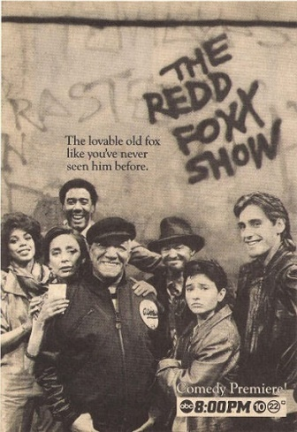
1980s
THE REDD FOXX SHOW – 1986, Al Hughes (Redd Foxx), a New York City diner/newsstand owner, adopts a streetwise teenager named Toni (Pamela Segall Adlon). Diana (Rosanna DeSoto) worked with Al in the newsstand, and Jim-Jam (Nathaniel Taylor or Theodore Wilson) owned a Chinese restaurant nearby. As the series progressed, Toni "disappeared," and in came Al's ex-wife Felicia (Beverly Todd) and his foster son, Byron (Sinbad).

Slide 31
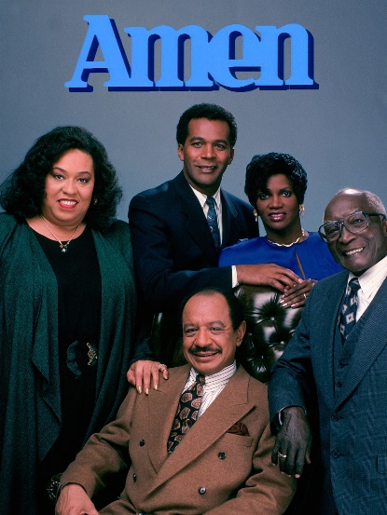
1980s
AMEN – 1986, a breakthrough comedy based on religion. The series revolves around Ernest Frye (Sherman Hemsley), a widower deacon of the First Community Church of Philadelphia, who also works as a lawyer. He is often dishonest and frequently gets into trouble with his many harebrained schemes. Frye has a single daughter named Thelma (Anna María Horsford). Reuben Gregory (Clifton Davis) is the new, young pastor of the church, and also the object of Thelma's affection. The two get married during season four, despite the fact that Gregory and Frye often butt heads. Storylines include guest characters dealing with alcoholism, teenage pregnancy, suicide prevention, sexism, jealousy and other issues. These issues are dealt with in a non-preachy manner.

Slide 32
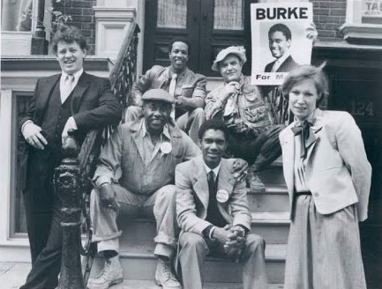
1980s
HE’S THE MAYOR – 1986, A 25-year-old Black man, Carl Burke (Kevin Hooks) is elected mayor of his hometown. His “kitchen cabinet” includes his father Alvin (Al Fann), who was the City Hall janitor, and his best friend Wardell ( Wesley Thompson) his chauffeur.

Slide 33
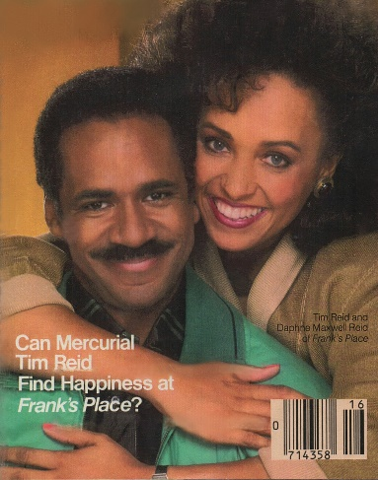
1980s
FRANK’S PLACE – 1987, Set in New Orleans, Frank's Place chronicles the life of Frank Parrish (Tim Reid), a well-to-do African American professor at Brown University, an Ivy League university in Providence, Rhode Island, who inherits a restaurant, Chez Louisiane. Tim’s real-life wife Daphne Reid plays Hanna Griffin.
In the premiere, Frank travels to New Orleans intending to sell the restaurant. Miss Marie (Frances E. Williams) has a voodoo spin (curse) put on Frank ensuring that he will come back to carry on his family's business. Unlike most sitcom productions of this era, Frank's Place was filmed with a single camera and used no laugh track.

Slide 34

1980s
A DIFFERENT WORLD – 1987, Lisa Bonet stars in this spin-off of the Cosby Show. The “different world” for Denise Huxtable was college, and where for the first time she is out from under the protective wing of her family. She is a sophomore at fictitious Hillman College, an HBCU, in which both her father and grandfather had attended. A pregnant Bonet was eased out after the first season, with Whitley Gilbert (Jasmine Guy) and Dwayne Wayne (Kadeem Hardison) becoming the main characters.

Slide 35
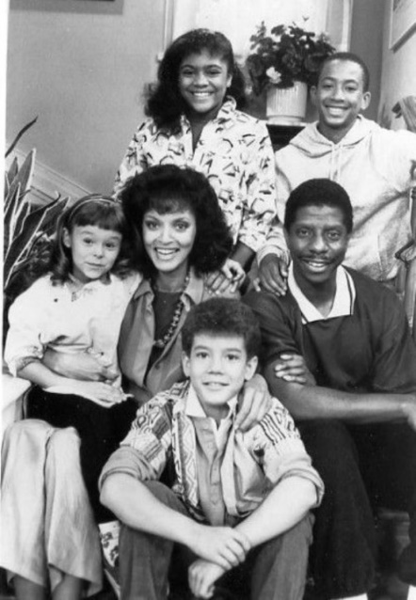
1980s
BUSTIN’ LOOSE – 1987, Jimmy Walker stars as Sonny Barnes, a small-time con man in Philadelphia with a penchant for telling tall tales about his nonexistent exploits and relationships with famous people. One of his scams resulted in five years of community service. Barnes was placed in the home of social worker Mimi Shaw (Vonetta McGee), who lived with four orphans: Rudey (Larry O. Williams, Jr.), Trish (Tyren Perry), Nikky (Aaron Lohr) and Sue Anne (Marie Cole). Sonny lived in the basement and worked around the house doing odd jobs. Meanwhile, the kids all loved listening to Sonny's exaggerated tales.

Slide 36
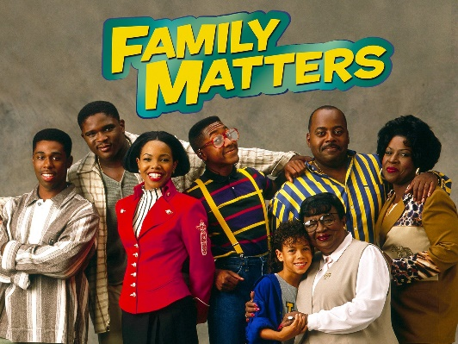
1980s
FAMILY MATTERS – 1989, Stars Carl (Reginald VelJohnson), a blustery, heavyset Chicago copy and his sharp-tongued wife Harriette (Jo Marie Payton) and their children Eddie (Darius McCrary), Laura (Kellie Williams) and Judy (Jaimee Foxworth). Steve Urkel (Jaleel White) is the nerdy neighbor with a serious crush on mortified Laura. With his oversized glasses, hiked-up jeans, and high-pitched voice, skinny Urkel was a walking cartoon and an instant sensation. Known for the catchphrase, “Did I do that?”.

Slide 37
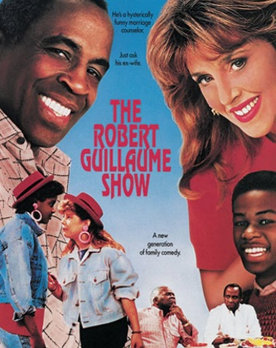
1980s
THE ROBERT GUILLAUME SHOW – 1989, The series starred Guillaume as Edward Sawyer, a marriage counselor and a divorced father with two uncontrollable teen-age children, who begins an interracial relationship with Ann (Wendy Phillips), his white secretary, who has a daughter of her own.

Slide 38
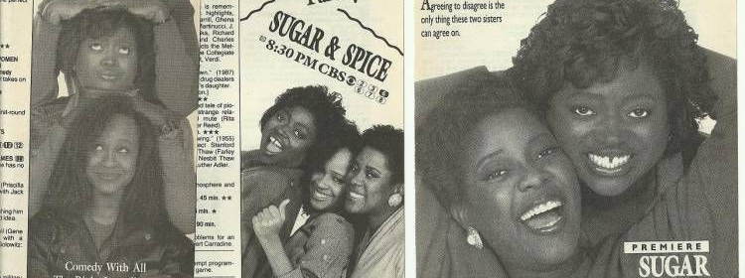
SUGAR AND SPICE – 1990, The small town of Ponca City, Oklahoma, was the setting for the blue-collar series about two-middle-aged Black sisters, Loretta (Loretta Devine) and Vickilyn (Vickilyn Renyolds), who had very different personalities and outlooks on life. Vickilyn was conservative and quiet, while Loretta was aspiring singer, flirt and hostess at the Café Jacques.
1990s

Slide 39
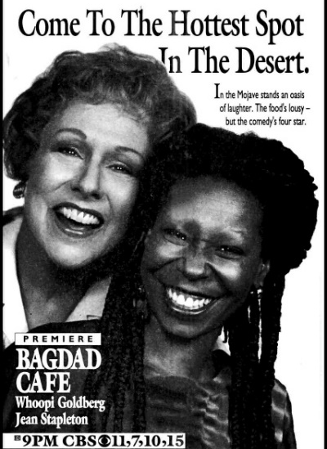
1990s
BAGDAD CAFÉ – 1990, Brenda (Whoopi Goldberg) and Jasmine (Jean Stapleton) are the female version of the “Odd Couple.” Brenda (Black) is owner of the Bagdad Café diner and motel, an isolated, flea-bitten rest stop in the middle of the Mojave Desert. Jasmine (White) arrives after her car breaks down. Jasmine is neat, structured and organized, while Brenda is a disorganized slob, and sometimes a crude, loud-mouthed cynic. The couple share a common thread, they are separated from their husbands.

Slide 40
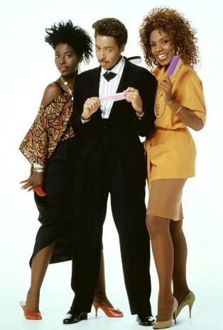
1990s
NEW ATTITUDE – 1990, The St. James sisters Vicki (Sheryl Lee Ralph) and Yvonne (Phyllis Yvonne Stickney) sunk everything they could beg or borrow into their beauty salon, New Attitude, where gossip was the premium feature. Lamarr (Morris Day) was their colorful top hairdresser and known as the “Prince of Perms.”

Slide 41
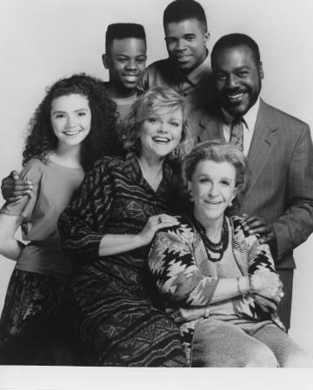
1990s
TRUE COLORS – 1990, Ron Freeman (Frankie Faison & Cleavon Little) was a widowed Black dentist with two teenage sons, and Ellen (Stephanie Faracy) was a divorced White kindergarten teacher with a teenage daughter. The kids were conveniently different, Terry (Claude Brooks) was an uptight conservative yuppie, and Lester (Adam Jeffries) was a jive talking free spirit, while Katie (Brigid Walsh) was a socially conscious environmental activist.

Slide 42
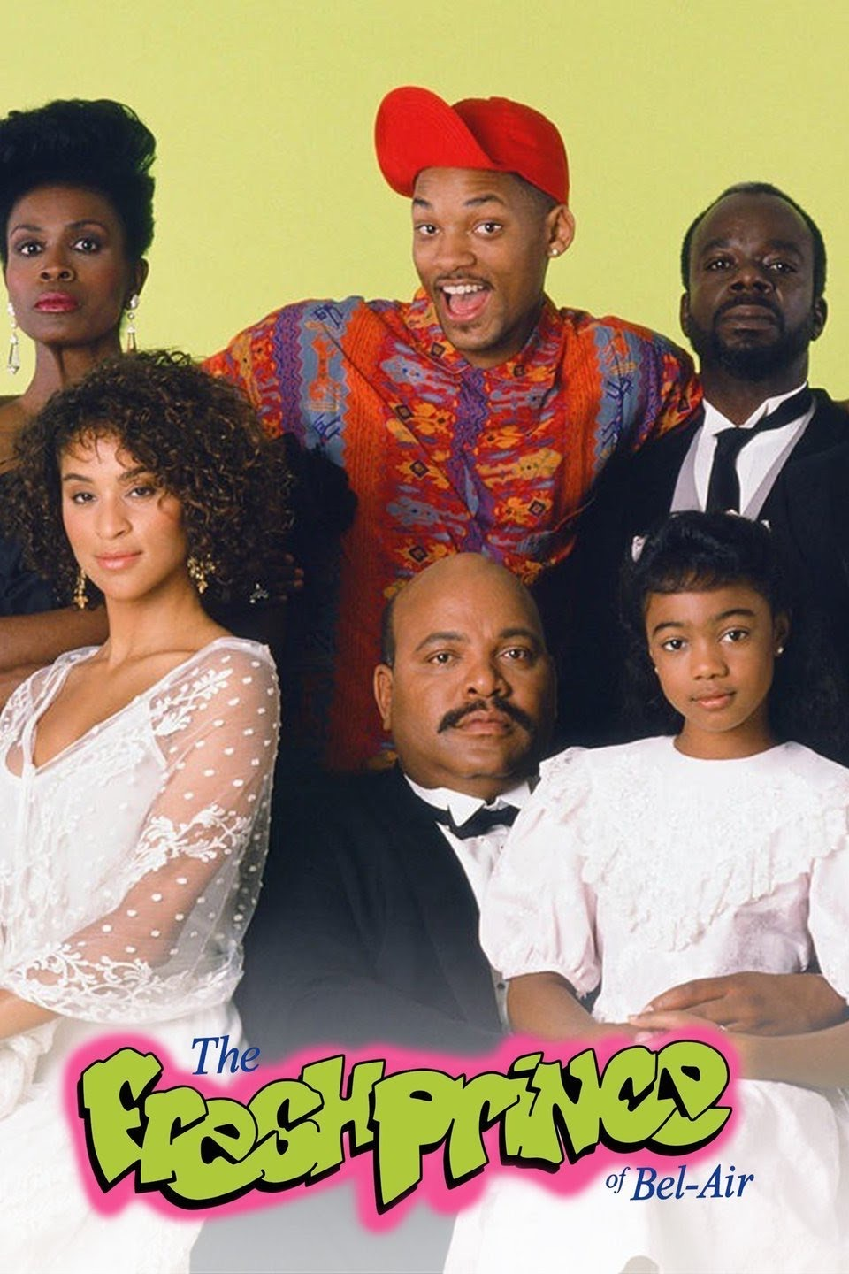
1990s
FRESH PRINCE OF BEL AIR – 1990, A Black rapper (Will Smith) from the West Philly ‘hood found himself living with wealthy relatives in Bel Air, California. Uncle Phil (James Avery) stars as the pompous attorney, and Aunt Vivian (Janet Hubert-Whitten & Daphne Maxwell Reid) is the peace maker. They live in an ornate mansion with bright-eyed butler Geoffrey (Joseph Marcell), a preppy, clueless son Carlton (Alfonso Ribeiro), a spoil-brat teenage daughter Hilary (Karyn Parsons) and the lovable little Ashley (Tatyana M. Ali).

Slide 43
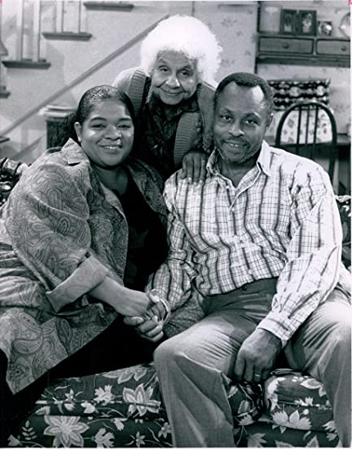
1990s
YOU TAKE THE KIDS – 1990, A short-lived comedy about a blue-collar family in Pittsburgh’s inner city. Michael (Roger E. Mosley) makes a modest living as a school-bus driver. His wife Nell (Nell Carter) of 17 years is opinionated but always loving, taught piano lessons at home for extra income. They raised four children. Nell’s loudmouthed mother Helen (Leila Danette) chastised her for not marrying better and was not shy about saying it in front of poor Michael.

Slide 44
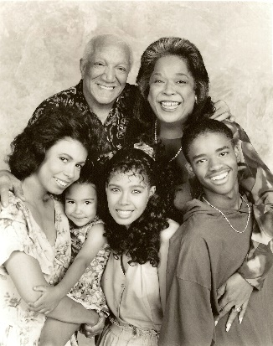
1990s
THE ROYAL FAMILY – 1991, Redd Foxx returns to TV to star as Al Royal, a cranky Atlanta mailman looking forward to retirement with his loving, if somewhat contentious wife Victoria (Della Reese). The show revolves around the return of his divorced daughter Elizabeth (Mariann Aaida), who wants to go to medical school, bringing along two teen-agers and a preschooler. The series was produced by comedian Eddie Murphy.

Slide 45
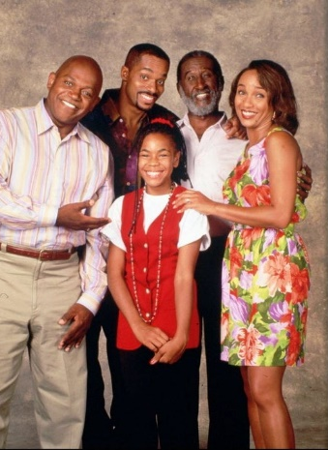
1990s
ROC – 1991, Roc Emerson (Charles Dutton) is a hard-working garbage man in Baltimore. Roc has a big heart and good instincts but at times struggles to handle family conflict. The steady force is his wife Eleanor (Ella Joyce) a nightshift nurse. Also in the household are Roc’s freeloading, gambling, womanizer, wannabe trumpet playing brother Joey (Rocky Carroll) and his father Andrew (Carl Gordon), a retired Pullman Porter. The series adopted a more dramatic tone, with several installments featuring social commentaries on gang activities, violence among youths, the consequences of drug use on childbirth, and the plight of African-Americans in the United States. The show was one of few shows that aired live.

Slide 46
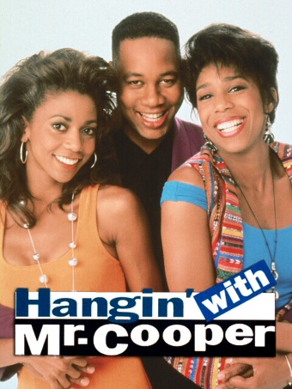
1990s
HANGIN’ WITH MR. COOPER – 1992, Mark Cooper (Mark Curry) is a tall, handsome former NBA player, and now high school coach in Oakland, CA, shares this condo with two beautiful women; Robin (Dawnn Lewis) a music teacher and Vanessa (Holly Robinson) who worked for a brokerage firm. Robin is later replaced by Cousin Geneva (Saundra Quarterman) and her seven-year-old daughter Nicole (Raven-Symone). Geneva later became principal at Mark’s high school, making her Mark’s boss and his tenant.

Slide 47
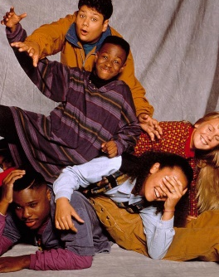
1990s
HERE AND NOW – 1992, A. J. (Malcolm-Jamal Warner) is a psychology graduate who volunteered to work at the Upper Manhattan Youth Center, a hotbed of at-risk kids. The series strived to reflect the black culture, overusing words like “yo” and “hey, man” caused concerns whether the sitcom was drama or comedy with a moral story.

Slide 48
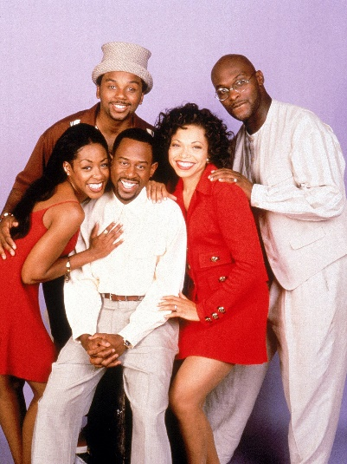
1990s
MARTIN – 1992, Martin Payne (Martin Lawrence) was a sexist, wisecracking talk show host on Detroit’s WZUP radio station. His girlfriend Gina (Tisha Campbell) was a marketing executive. Gina’s sarcastic secretary Pam was played by Tichina Arnold who had a symbiotic relationship with Martin. Character Sheneneh Jenkins, a flashy, loudmouthed bimbo with an attitude, was Martin’s alter ego. The crazy hat wearing Cole (Carl Anthony Payne) and the debonair and sharp dresser Tommy (Thomas Mikal Ford) provided endless comedy relief.

Slide 49
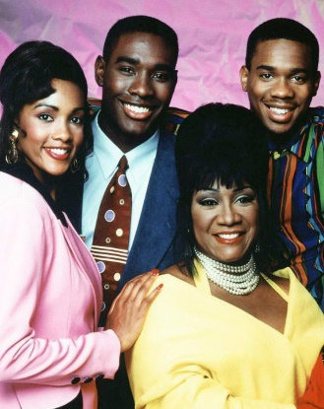
1990s
OUT ALL NIGHT – 1992, Grammy winner Patti LaBelle starred as a former singing star and owner of the high-tech LA nightclub called Club Chelsea, was the hippest, trendiest spot around with flashing lights, high-energy dancers with a big-time video wall. Vidal (Duane Martin) was in constant pursuit of Chelsea’s daughter (Vivica A. Fox) who was a fashion stylist. Promising entrepreneur Jeff (Morris Chestnut) was the manager-trainee. Dance routines and songs by popular groups encourage viewership.

Slide 50
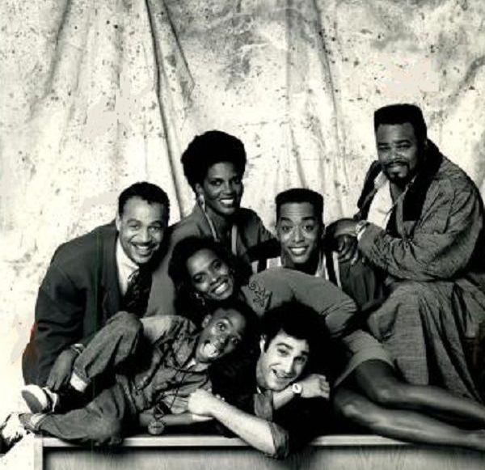
1990s
RHYTHM & BLUES – 1992, A white disc jockey Bobby Soul (Roger Kabler) turned a dying an all-Black Detroit radio station on its ear. The station’s owner Veronica (Anna María Horsford) often consulted with the husband’s ashes, kept in the urn behind her desk. Don (Ron Glass) was former singer with the Five Tops (later known as the Four Tops), and “The Love Man” was played by Troy Curvey, Jr., an overweight deejay playboy, who referred to himself in the third person. Miguel A. Núñez, Jr., played deejay Jammin’ and Vanessa Bell Calloway as the program director.

Slide 51
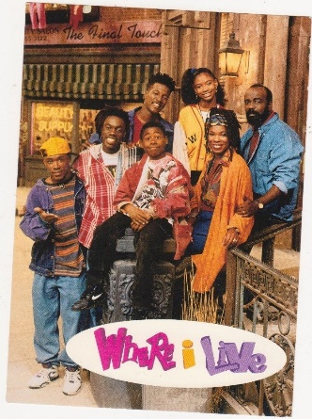
1990s
WHERE I LIVE – 1993, The series starred Doug E. Doug as Douglas St. Martin, a Trinidadian American teenager living in the Harlem known as “the center of the universe.” He lived with his caring, hard-working parents and his younger sister. Much of the show focused on Douglas's misadventures with his best friends, Reggie (Flex Alexander) and Malcolm (Shaun Baker). The show was based on Doug E. Doug's own childhood. The series drew critical acclaim for its realistic portrayals, but the show brought in low ratings, despite consultant Bill Cosby’s input.

Slide 52
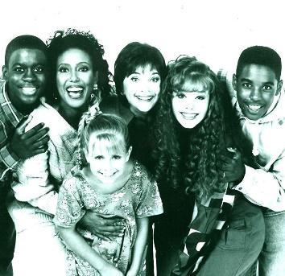
1990s
GETTING BY – 1993, The white mom Cathy (Cindy Williams, from Laverne & Shirley) and Black mom Dolores (Telma Hopkins) merged their families to save a few bucks. They shared an office as social workers and a home in the Chicago suburb of Oak Park. Dolores had two sons, Marcus (Merlin Santana) and Darren (Deon Richmond). Cathy had two daughters, Nikki (Nicki Vannice) and Julie (Ashleigh Blair Sterling).

Slide 53
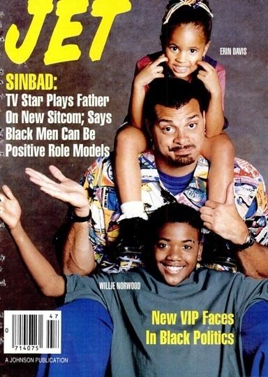
1990s
THE SINBAD SHOW – 1993, Big fellow David Bryan (Sinbad) was a struggling young computer video game designer living the Silicon Valley of San Francisco, who took in two foster children, the lovable five-year old Zana (Erin Davis) and smarty pants 13-year-old Little John (Willie Norwood). The adoption forced David’s best friend to move out. Clarence (T. K. Carter) was a born hustler and womanizer, who still wanted to hang out with now fatherly David. Sinbad used funny demonstrations to explain scientific principles to the audience via his TV show It’s Science Time.

Slide 54

1990s
TALL HOPES – 1993, Comedian George Wallace starred as a none-too-bright transit cop in Philly with three children; 16-year-old Chester or “Chet the Jet” (Terrence Howard), not the brightest bulb in the room, 14-year-old Ernest (Kenny Blank) an honor student and six-year-old DeeDee (Karla Green), a sweet child. Mom Lainie (Anna María Horsford) often meditated during hectic times. Everyone confided their thoughts to the savant Ernest, who shared everything with his camcorder to the audience.

Slide 55

1990s
THEA – 1993, Widow Thea played by Thea Vidale is a loud and loving mother, who ruled her kids with tough love. The four rambunctious kids were the serious Jarvis (Adam Jeffries, age 16), the conspirator Jerome (Jason Weaver, age 14), the shy Danesha (Brandy Norwood of Moesha, age 12) and cute little James (Brenden Jefferson, age 7). Despite juggling several jobs, the little rascals could never escape her stare of “Thea knows all, Thea sees all!”

Slide 56

1990s
LIVING SINGLE – 1993, Khadijah (Queen Latifah) was the editor of Flavor, a Black women’s magazine. She lives with her quirky cousin Synclaire (Kim Coles), a wannabe actress was secretary at Flavor, and the gold-digging man chaser Regine (Kim Fields). Divorce attorney Max (Erika Alexander) was Khadijah’s college roommate had her flirtatious verbal battles with Kyle (T. C. Carson), a conceited financial planner. The shy, and always funny Overton (John Henton) was the building’s happy-go-lucky handyman who kinda like Synclaire and vice-versa.

Slide 57

1990s
SISTER, SISTER – 1994, Tia and Tamera Mowry are identical twins separated at birth who are reunited as teenagers. Tia Landry (Tia Mowry) is the intelligent twin from inner city Detroit, where her adoptive mother Lisa (Jackée Harry) works as a fashion designer; Tamera Campbell (Tamera Mowry) is the boy-crazy twin from the suburbs, where her adoptive father Ray (Tim Reid) owns a successful limousine service. After their unexpected reunion, Ray reluctantly allows Tia and Lisa to move in because Lisa was about to take a job in St. Louis, which would have separated the girls again. Roger Evans (Marques Houston) is Tia and Tamera's nerdy annoying neighbor and friend. The girls frequently reject his amorous advances.

Slide 58

1990s
704 HAUSER – 1994, The series is built around the concept of a Black family, the Cumberbatch Family, moving into the former Queens home of Archie and Edith Bunker after the Bunkers had sold the house located at 704 Hauser Street. Ernie Cumberbatch (John Amos) is an auto mechanic and an outspoken liberal. In fact, he named his only son, Goodie (T. E. Russell), after the first Black Supreme Court justice, Thurgood Marshall. Goodie became a politically conversative who dated a white, outspoken, Jewish girl named Cheryln (Maura Tierney). Ernie’s wife Rose (Lynnie Godfrey) relied on her Christian faith to keep peace between her husband and their son.

Slide 59

1990s
ME AND THE BOYS – 1994, A widowed dad Steve (Steve Harvey) and owner of a video store, is raising his three boys, Artis (Chaz Lamar Shepherd) a slacker, William (Wayne Collins) the schemer and Andrew (Benjamin D. LeVert) a cute 10-year-old. Mary (Madge Sinclair) was the comforting live-in mother-in-law. While Amelia (Wendy Raquel Robinson) played Steve’s sensible girlfriend.

Slide 60

1990s
ON OUR OWN – 1994, The series stars Josh Jerrico/Aunt Jelcinda (Ralph Louis Harris) and six real life siblings: Jazz, Jocqui, Jake, Jojo, Jurnee, and Jussie Smollett. The Jerrico family, consisting of seven brothers and sisters live in the O'Fallon Park neighborhood of St. Louis who lose their parents and are being raised by the eldest brother, Josh. The early episodes focused on the siblings attempting to not be split up by authorities. This inspires Josh, the eldest brother, who was trying to raise the family alone, to dress in drag and pose as older guardian, Aunt Jelcinda (also known as "Mama J"), to fool their case worker, Alana Michaels (Kimberley Kates). Alana quickly sees through the charade but decides to help the family stay together.

Slide 61

1990s
IN THE HOUSE – 1995, Marion Hill (LL Cool J) is a former professional football player. Because of his financial predicament, Marion is forced to rent out most of the rooms in his house to newly divorced single mother Jackie Warren (Debbie Allen) and her two children, Tiffany (Maia Campbell) and Austin (Jeffery Wood). After the second season, the series was retooled, becoming more adult-oriented. Jackie and Austin both moved back East while Tiffany stayed with Marion to finish high school. Joining the cast for the third season was Alfonso Ribeiro as Dr. Maxwell and Kim Wayans as Tonia Harris. Both Maxwell and Tonia helped Marion manage the Los Angeles sports clinic he owns, then Tonia leaves for the WNBA after Season 4, and Tiffany leaves after only two episodes in Season 5,

Slide 62

1990s
THE PARENT ‘HOOD – 1995, Robert Peterson (Robert Townsend) was a professor of communications at N.Y.U. His wife Jerri (Suzzanne Douglas) was in law school. Michael (Kenny Blank) was a prankster, and sister Zaria (Reagan Gómez-Preston) was mostly interested in chasing boys. Nicholas (Curtis Williams) is a bright-eyed eight-year-old who has discovered the joys of mischief. Four-year-old Cece (Ashli Amari Adams) is the darling of the family. Robert's childhood buddy Wendell (Faizon Love) offers his own unique viewpoint. The Peterson family was very similar to the Huxtable family.

Slide 63

1990s
THE WAYANS BROS. – 1995, Shawn and Marlon Williams (Shawn Wayans and Marlon Wayans) are brothers who live in an apartment on 117th street in Harlem and own a local newsstand. Shawn, a womanizing, stylish and responsible young bachelor and Marlon's older brother. Younger brother Shawn is a dimwitted, immature, sex crazed, unsanitary and lazy dude. John "Pops" Williams (John Witherspoon), plays their dysfunctional tacky father who owns a famed diner next to the newsstand.

Slide 64

1990s
CLEGHORNE! – 1995, Ellen Carlson (Cleghorne), is a single mom, who runs a struggling television commercial production company and trying to raise her nine-year-old daughter Akeyla (Cerita Monet Bickelmann) on Manhattan's Upper West Side. Ellen tries to balance raising her daughter, running a company in SoHo in Lower Manhattan, and interference from her overbearing parents, Sidney (Garrett Morris) and Lena (Alaina Reed Hall), who lived next door. Sherri Shepherd plays Victoria, Ellen's dim-witted sister who aspires to become a model.

Slide 65

1990s
MINOR ADJUSTMENTS – 1995, Standup comic Rondell Sheridan plays Dr. Ron Aimes, a child psychologist in Philly. Rachel (Wendy Raquel Robinson) was his savvy wife, with 10-year-old son Trevor (Bobby E. McAdams II) and four-year-old daughter Emma (Camille Winbush). Ron shared an office with fussy orthodontist Dr. Bruce (Mitchell Whitfield) and a neurotic pediatrician Dr. Francine (Linda Kash).

Slide 66

1990s
GOODE BEHAVIOR – 1996, Willie (Sherman Hemsley) was a paroled con artist whose freedom was contingent on living with his son Franklin (Dorien Wilson), who he had not seen in 15 years. Willie moved in under house arrest – complete with ankle bracelet – forcing Franklin and his wife and television news anchor, Barbara (Alex Datcher) to make some lifestyle adjustments.

Slide 67

1990s
COSBY – 1996, After 30-years as an airline employee, Hilton Lucas (Bill Cosby) is pink-slipped and becomes a cranky 60-year-old, but lovable fellow. His wife Ruthie (Phylicia Rashad) worked part-time at a flower shop in Queens, NY. The struggling flower shop started selling their daughter, Erica’s (T’ Keyah Crystal Keymah) cookies and coffee and became a popular place and was rechristened The Flower Café.

Slide 68

1990s
HOMEBOYS IN OUTER SPACE – 1996, Ty (Flex) and Morris (Darryl Bell) are a pair of 23rd-century Black guys who traveled from planet to planet across the galaxy in their Space Hoopty – a small spaceship which, from the outside, looked like an oversized beat-up junker. Morris was serious and had aspirations of becoming a starship commander, but Ty was a fun-loving friend with raging hormones and outrageous hair, caused both guys to be expelled from Starship Commander Community College.

Slide 69

1990s
BUDDIES – 1996, Chicago childhood friends Dave (David Chappelle) and John (Christopher Gartin) start a small film and videotaping company which they hoped would lead them to Hollywood, but for now they settled for taping bar mitzvahs and weddings. Richard Roundtree played Dave’s no-nonsense father and landlord.

Slide 70

1990s
THE JAMIE FOXX SHOW – 1996, Jamie King (Jamie Foxx) is an aspiring musician from Terrell, Texas, who has come to Los Angeles to pursue a career in entertainment. To support himself, he worked at his family's hotel, the financially strapped King's Tower, which is owned by his Aunt Helen (Ellia English) and Uncle Junior King (Garrett Morris). Among his co-workers were the beautiful and intelligent front desk clerk Francesca "Fancy" Monroe (Garcelle Beauvais) and Jamie's high-strung, stuffed-shirt, "bourgeois" nemesis Braxton P. Hartnabrig (Christopher B. Duncan) who works as an accountant for the King's Tower.

Slide 71

1990s
MALCOLM AND EDDIE – 1996, Malcolm (Malcolm-Jamal Warner) is a responsible and sensible lad who ends up sharing an apartment and a business venture with relentlessly enthusiastic tow truck owner Eddie (Eddie Griffin) in Kansas City, Missouri. A fast talker with outlandish frenetic energy, Eddie's charming naiveté always seems to get the duo into hot water. But no matter what the situation, these opposites always end up bailing each other out. When the guys unexpectedly became recipients of a considerable sum of money, Malcolm and Eddie decided to buy not only the old Irish pub below their apartment, but the entire building, including Eddie's garage, as an investment. As new bar owners, the guys gave the place a face lift by turning it into a sports bar and renaming it McGee's.

Slide 72

1990s
MOESHA – 1996, A show about an upper-middle-class Black family through the eyes of a typical girl named Moesha (Brandy Norwood). Her father Frank (William Allen Young), a widower and Saturn car salesman (and later owner of his own dealership, Brothers Saturn), has married Dee (Sheryl Lee Ralph), the vice principal at Moesha's high school, much to Moesha's disapproval. The popular show dealt with real social issues affecting teenagers, such as premarital sex, the death of a parent, teen pregnancy, drug use, race relations, sexuality, dementia, and day-to-day issues teenagers faced at home and school such as gender prejudice and inequality.

Slide 73

1990s
SPARKS – 1996, A sitcom set in Compton, California, and is about the everyday lives of lawyers in a family-owned law practice. Alonzo (James Avery) is the patriarch with plans to leave the firm to his two sons, Maxey (Miguel Núñez, Jr.), a flashy dresser and ladies’ man, and Greg (Terrence Howard), a conservative and thoughtful attorney. Wilma (Robin Givens) is the sexy Stanford Law School grad who has the romantic attention of both sons.

Slide 74

1990s
THE STEVE HARVEY SHOW – 1996, Steve Hightower (Steve Harvey) is a 1970s funk legend who is now a music, drama and art teacher/vice principal at Booker T. Washington High School on Chicago's West Side. Cedric Robinson (Cedric the Entertainer) is a coach at the high school, and Steve's longtime best friend. The principal is Steve's former classmate, Regina (Wendy Raquel Robinson), whom Steve affectionately calls "Piggy" because she was overweight in childhood. Regina’s secretary is outspoken drama queen Lovita Jenkins (Terri J. Vaughn). Steve forms a strong bond with two of his students: Romeo Santana (Merlin Santana), a stylish, self-absorbed ladies' man, and the equally juvenile Bullethead (William Lee Scott) - acting as their mentor, and gradually, accepts them as friends.

Slide 75

1990s
SMART GUY – 1997, Set in Washington, D.C., the show centers on the misadventures of boy genius and youngest child T. J. (Tahj Mowry), who at the age of 10 moves from elementary school and gets transferred to Piedmont High School. He must adjust to the life with older, but not necessarily wiser, high school teenagers – including his brother Marcus (Jason Weaver) and Marcus' best friend Mo (Omar Gooding). Episodes typically deal with T. J.'s missteps of trying to fit in as a kid genius, in high school, as well as the contrast between his smarts and his brother's underachieving nature. Essence Atkins plays T. J.’s and Marcus’s sister Yvette. Floyd (John Marshall Jones), is a widowed single father who owns his own roofing business, deals with the problems of raising his three kids.

Slide 76

1990s
ARSENIO – 1997, Hall starred as Michael Atwood, the host of a sports cable show on ASTV in Atlanta. Michael is also newly married with his lawyer wife Vivian (Vivica A. Fox). His co-host is Al (Kevin Dunn), who Michael sometimes asks for advice on his home life. Living with Michael and Vicki is Vicki's younger brother Matthew (Alimi Ballard), a Harvard graduate who is not ready to take on the real world. Shawnee Smith also co-starred as Vicki's sarcastic, bleached-blond, free-spirited old college mate Laura who is always encouraging Vicki to let loose.

Slide 77

1990s
BETWEEN BROTHERS – 1997, Four Black men share an apartment in Chicago. Charles (Kadeem Hardison) and James (Dondré T. Whitfield) are brothers. Charles is a sportswriter for The Chicago Examiner while irresponsible little brother James sold real estate. Mitchell (Tommy Davidson) - the mooch, a junior high school history teacher, returned to the apartment after his second wife, Audrey, kicks him out. Dusty (Kelly Perine), the short fellow with the loud clothes, had moved up from Indiana to take a job as a weekend anchor on WEQT-TV.

Slide 78

1990s
BUILT TO LAST – 1997, The series was based on the real-life family of Black comedian Royale Watkins, who put his career on hold to help run the family business, Watkins Construction, after his cranky father Russel (Paul Winfield) suffered a mild heart attack. Royale often dueled with his older brother Robert (Geoffrey Owens) an architect, and teenager Randal (J. Lamont Pope) and chubby sister Tammy (Natalie Desselle). Sylvia (Denise Dowse) was the bossy Mom. Actor Royale’s real-life father ran the authentic Watkins Construction in Washington, DC, which was more successful than the series.

Slide 79

1990s
THE GOOD NEWS – 1997, David Randolph (David Ramsey), is a young acting pastor designated to Compton, California's African American Church of Life. Initially, the majority of the church's members balk at the young pastor's new position and resent him replacing their former pastor. With the help of the church's secretary, Vera (Rose Jackson Moye), Randolph attempts to reunite the church and help his congregation. Other cast members included Roz Ryan as Hattie, the church's cook, Tracey Cherelle Jones as the church's youth director, and Little T (Guy Torry) as a choir member and janitor.

Slide 80

1990s
THE GREGORY HINES SHOW – 1997, Gregory Hines stars as Ben Stevenson, a publishing agent and widower raising 12-year-old son Matty (Brandon Hammond). A year and a half after his wife's death, Ben decides to resume his social life and begin dating again. He soon realizes that he has a lot to re-learn about women, just as his son is learning about them for the first time. Ben and Matty had previously had no trouble talking about anything, but now even the simplest conversation has become complicated, especially when the topic is the women in their lives. Now and then, Ben receives advice from his brother Carl (Wendell Pierce), his father James (Bill Cobbs), as well as his co-worker Alex (Mark Tymchyshyn), Alex's ex-wife, Nicole (Robin Riker) and his assistant Angela (Judith Shelton).

Slide 81

FOR YOUR LOVE – 1998, Revolves around three couples in different stages of togetherness in the integrated, upscale Chicago suburb of Oak Park, IL. The longest tenure couple were architect Dean (D.W. Moffett) and Sheri (Dedee Pfeiffer), the newlyweds were attorney Mel (James Lesure) and psychiatrist Malena (Holly Robinson Peete), and the dating Reggie (Edafe Blackmon) a restauranteur and Bobbi (Tamala Jones). The three couples chattered about life, love and lust.
1990s

Slide 82

1990s
DAMON – 1998, Two brothers, one a bachelor and undercover detective, the other a married rent-a-cop, are reunited in Chicago. Things come easily to Damon (Damon Wayans), a clever but politically incorrect undercover cop. He has a quick wit, beautiful women and a challenging job. His older brother Bernard (David Alan Grier) is a rent-a-cop home security officer who longs to be the real thing. Down on his luck and separated from his wife, he spends most of his time on Damon's couch.

Slide 83

1990s
GETTING PERSONAL – 1998, Robyn (Vivica A. Fox) was an administrative executive for Old Dog Productions, who had a disastrous blind date with Milo (Duane Martin), the firm’s self-centered creative director. They found each other attractive but their egos would not allow a personal or a business relationship. Sam (Jon Cryer) was Milo’s best friend, and the company’s film editor, rode a bicycle to work and played bass with a jazz combo for recreation.

Slide 84

1990s
THE HUGHLEYS – 1998, A upwardly mobile Black man worried about losing his “blackness” in the ‘90s version of The Jeffersons. A successful vending-machine business owner Darryl Hughley (D.L.) moved his family from South Los Angeles to West Hills, a predominantly white neighborhood in the San Fernando Valley. Darryl and his family try to adjust to living in an all-white area while trying not to forget who they are and where they came from. Darryl and his wife Yvonne (Elise Neal) befriend their new neighbors, Sally (Marietta DePrima) and Dave (Eric Allan Kramer), who are Darryl's polar opposite. John Henton portrayed the couple's best friend Milsap from the "old neighborhood.” The story has many racial themes that are usually comedic as Darryl makes fun of other races, especially his white and Korean neighbors.

Slide 85

1990s
GUYS LIKE US – 1998, The series is centered around bachelors Sean (Chris Hardwick) and Jared (Bumper Robinson), and Jared's six-year-old hyperactive brother Maestro (Maestro Harrell), who comes to live with them after Jared's father accepts a job to build a dam in Venezuela. Now the two bachelors must give up some of their perks to develop their crude parenting skills.

Slide 86

1990s
THE PARKERS – 1999, The series centers around a mother and daughter who attend Santa Monica College. Nikki Parker (Mo’Nique) was forced to drop out of high school when she discovered she was pregnant with her daughter Kim (Countess Vaughn). After Kim reaches adulthood, Nikki decides to go back to school and graduates along with Kim. When Nikki reveals she wants to attend Santa Monica College too, Kim is initially mortified but eventually accepts the situation. Nikki and Kim's mother-daughter relationship evolves as roommates and as students. Nikki adjusts to the fact that her daughter is old enough to live on her own, while Kim realizes that Nikki has more going on than just being her mom. Dorien Wilson played Professor Stanley Oglevee, a love interest of Nikki.

Slide 87

1990s
SECRET DIARY OF DESMOND PFEIFFER – 1999, A Black English nobleman named Desmond Pfeiffer (Chi McBride), chased out of the United Kingdom due to gambling debts, becomes President Abraham Lincoln's valet. In the show, he serves as the intelligent and erudite backbone of a Civil War-era White House populated by ruffians and drunkards. Lincoln was played as a fool, his wife Mary Todd as a horny shrew and General Ulysses Grant as a drunk.

Slide 88

Antoinette "Toni"(Jill Marie Jones) [far left] has been Joan's friend since they were eight-years-old, they attended elementary, high school, and college together. Toni grew up on poor on a farm with an alcoholic mother in Fresno, California. Toni is considered the shallow and popular one of the girlfriends and is the self-proclaimed "cute one" of the group.
Joan (Tracee Ellis Ross) [second from right] is considered the unofficial "den mother" of the group, as she frequently looks out for her friends even at the expense of dealing with her own problems, which are plentiful throughout the series.
GIRLFRIENDS – 2000
Maya (Golden Brooks) [second on left] is a former assistant to Joan and a housewife/author. Maya grew up in Compton, California and is married to her high school sweetheart, Darnell. They have one child, Jabari. Maya is the youngest and sassiest of the group and is often at odds with Toni over her ego-driven lifestyle.
Lynn (Persia White) [far right] was Joan and Toni's roommate at UCLA and lived with Joan for eight years before the series begins. Lynn holds five post-graduate degrees. Born in Virginia to a Black father and a bipolar white mother from a wealthy family, Lynn was adopted by a white family in Seattle (her dad affectionately calls her "Noodle"). She did not embrace her black heritage until college.

Slide 89
REFERENCES:
Bogle, Donald. Prime Time Blues: African Americans on Network Television. Canada: Farrar, Straus and Giroux, 2001.
Brooks, Tim and Earl Marsh. The Complete Directory of Prime Time Network and Cable TV shows, 1946-Present (Seventh Edition). New York: Ballantine Books, 1999.
Littleton, Darryl. Black Comedians on Black Comedy: How African-Americans Taught Us to Laugh. New York: Applause Theatre & Cinema Books, 2006.
Watkins, Mel. On the Real Side: A History of African American Comedy from Slavery to Chris Rock. Chicago: Lawrence Hill Books, 1994.

